Slide 1
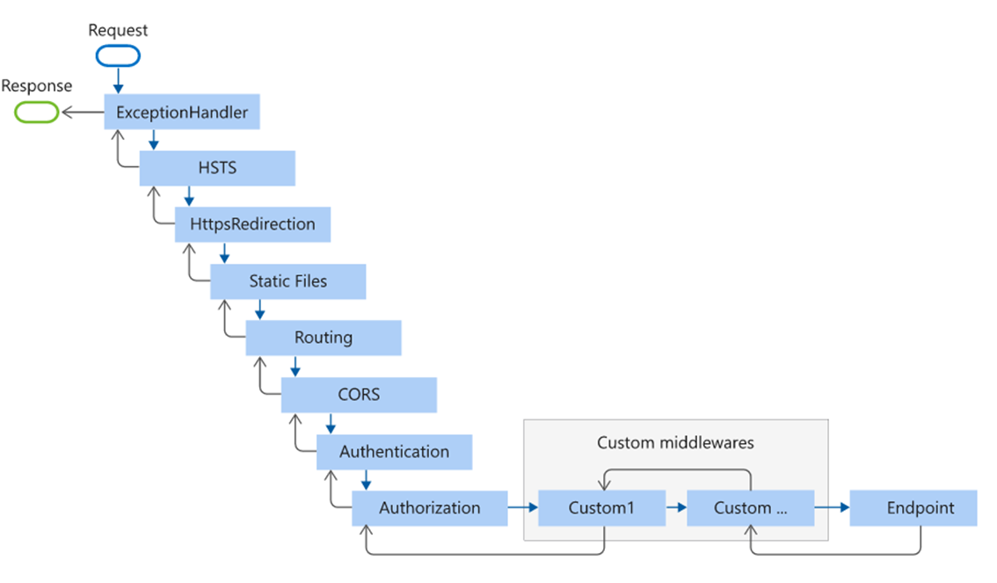
What is the Execution Order of Middleware Components in ASP.NET Core Application?
It is very important to understand the execution order of Middleware components. The ASP.NET Core middleware components are executed in the same order as they are added to the pipeline. So, we need to take care when adding the middleware components to the request processing pipeline.
As per your application’s business requirements, you may add any number of Middleware components. For example, if you are developing a static web application with some static HTML pages and images, then you may require only “StaticFiles” middleware components in the request processing pipeline.
But, if you are developing a secure dynamic data-driven web application then you may require several middleware components such as Logging Middleware, Authentication middleware, Authorization middleware, MVC middleware, etc.
https://learn.microsoft.com/en-us/aspnet/core/fundamentals/middleware/?view=aspnetcore-7.0

Slide 2

What are Request Delegates in ASP.NET Core?
In ASP.NET Core, Request delegates are used to build the request pipeline i.e. request delegates are used to handle each incoming HTTP request. In ASP.NET Core, you can configure the Request delegates using the Run, Map, and Use extension methods.
You can specify a request delegate using an in-line anonymous method (called in-line middleware) or you can specify the request delegates using a reusable class.
These reusable classes and in-line anonymous methods are called middleware or middleware components. Each middleware component in the request processing pipeline is responsible for invoking the next component in the pipeline or short-circuiting the pipeline by not calling the next middleware component.

Slide 3
What is the use of the Use and Run method in ASP.NET Core Web Application?
In ASP.NET Core, you can use the “Use” and “Run” extension methods to register the Inline Middleware component into the Request processing pipeline. The “Run” extension method allows us to add the terminating middleware (the middleware which will not call the next middleware components in the request processing pipeline). On the other hand, the “Use” extension method allows us to add the middleware components which may call the next middleware component in the request processing pipeline.
As you can see, in the configure method, three middleware components are registered in the request processing pipeline
UseDeveloperExceptionPage() Middleware component
UseRouting()
UseEndpoints() Middleware component

Slide 4
UseExceptionHandler Middleware Component:
UseExceptionHandler() middleware component is registered into the pipeline and this middleware component will come into the picture only when the hosting environment is set to “development”. This middleware component is going to execute when there is an unhandled exception occurred in the application and since it is in development mode, it is going to show you the culprit line of code. You can consider this as a replacement for the yellow screen of death.
UseRouting() Middleware Component:
This middleware component is used to add Endpoint Routing Middleware to the request processing pipeline i.e. it will map the URL (or incoming HTTP Request) to a particular resource.

Slide 5
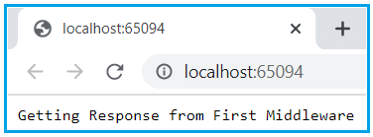
Let us understand how to create and configure custom middleware components using the Run extension method. First of all, comment on all codes which are present inside the Configure method.
Once you comment on the existing code, then copy and paste the following code.
The following code simply adds a new middleware component to the application’s request pipeline and simply prints a message.
app.Run(async (context) =>{
await context.Response.WriteAsync("Getting Response from First Middleware");
});

Slide 6
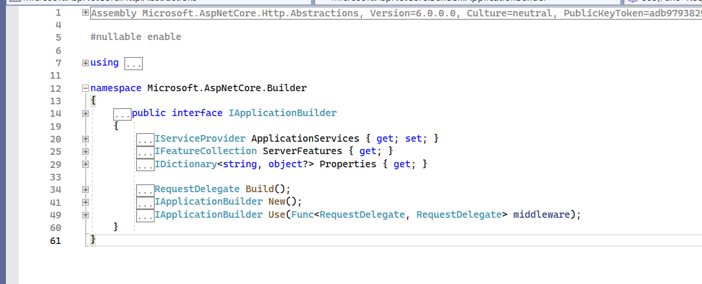
We are invoking the Run() on instance of IApplicationBuilder
As you can see from the definition of the Run() method, it is implemented as an extension method of the IApplicationBuilder interface.
This is the reason why we are able to call the Run() method using the IApplicationBuilder instance i.e. app.
You can also see from the above image that the Run() method takes an input parameter of type RequestDelegate. Following is the definition of RequestDelegate.
As you can see from the above image, the RequestDelegate is a delegate that takes an input parameter of type HttpContext object.
using Microsoft.AspNetCore.Http;
namespace Microsoft.AspNetCore.Builder
{
//
// Summary:
// Extension methods for adding terminal middleware.
public static class RunExtensions
{
// handler:
// A delegate that handles the request.
public static void Run(this IApplicationBuilder app
, RequestDelegate handler);
}
}

Slide 7
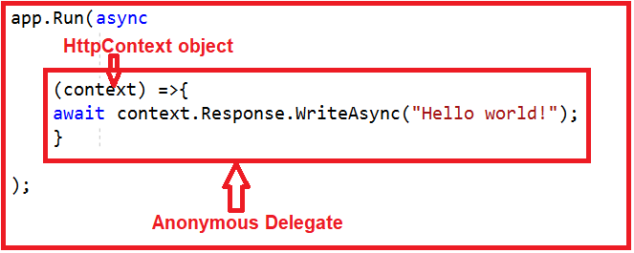
As we already discussed the middleware components in the ASP.NET Core application can have access to both HTTP Request and Response and this is because of the above HttpContext object.
In our example, we are passing the request delegate inline as an anonymous method using lambda expression and moreover, we are passing the HTTPContext object as an input parameter to the request delegate. The following diagram shows the above
Note: Instead of passing the request delegate inline as an anonymous method, you can also define the request delegate in a separate class and pass it here

Slide 8
Add one more middleware to the application.
To do so, modify the configure method of the Startup class as shown below.
app.Run(async (context) =>{
await context.Response.WriteAsync("Getting Response from First Middleware");
});
app.Run(async (context) =>{
await context.Response.WriteAsync("Getting Response from Second Middleware");
});
}
Now we have two middleware components registered with the Run() extension method. If you run the application then you will get the following output.
Getting Response from 1st Middleware
The output is coming from the first middleware component. The reason is, when we registered a middleware component using the Run() extension method then that component becomes a terminal component means it will not call the next middleware component in the request processing pipeline.

Slide 9
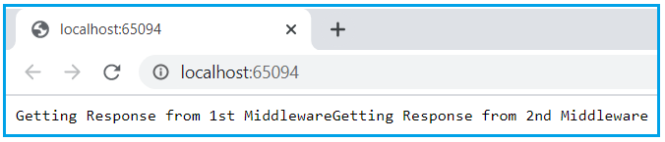
Configuring middleware component using the Use extension method
Then the question that comes to your mind is how to call the next component in the request processing pipeline, the answer is to register your middleware component using the Use extension method as shown below.
using MVC_Mock_Class.Models;
namespace MVC_Mock_Class
{
public class Program
{
public static void Main(string[] args)
{
var builder = WebApplication.CreateBuilder(args);
// Add services to the container.
builder.Services.AddControllersWithViews();
builder.Services.AddSingleton<IEmployeeRepository, MockEmployeeRepository>();
var app = builder.Build();
// Configure the HTTP request pipeline.
if (!app.Environment.IsDevelopment())
{
app.UseExceptionHandler("/Home/Error");
// The default HSTS value is 30 days. You may want to change this for production scenarios, see https://aka.ms/aspnetcore-hsts.
app.UseHsts();
}
app.UseHttpsRedirection();
app.UseStaticFiles();
app.UseRouting();
app.UseAuthorization();
app.Use(async (context, next) =>
{
await context.Response.WriteAsync("Getting Response from 1st Middleware");
await next();
await context.Response.WriteAsync("Getting reverse from 1st Middleware");
});
app.Run(async (context) =>
{
await context.Response.WriteAsync("Getting Response from 2nd Middleware");
});
/*
app.MapControllerRoute(
name: "default",
pattern: "{controller=Home}/{action=Index}/{id?}");
*/
app.Run();
}
}
}
Now run the application and you will see the output as expected which is coming from both the middleware components.

Slide 10
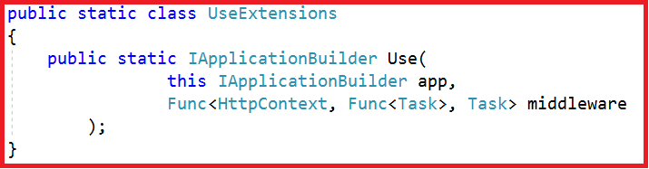
Understanding the Use extension method:
The Use extension method adds a middleware delegate defined in-line to the application’s request pipeline. Following is the definition of the Use extension method:
This method is also implemented as an extension method on the IApplicationBuilder interface. This is the reason why we are able to invoke this method using the IApplicationBuilder instance. As you can see from the above definition, this method takes two input parameters. The first parameter is the HttpContext context object through which it can access both the HTTP request and response. The second parameter is the Func type i.e. it is a generic delegate that can handle the request or call the next middleware component in the request pipeline.
Note: If you want to send the request from one middleware to the next middleware then you need to call the next method.

Slide 11
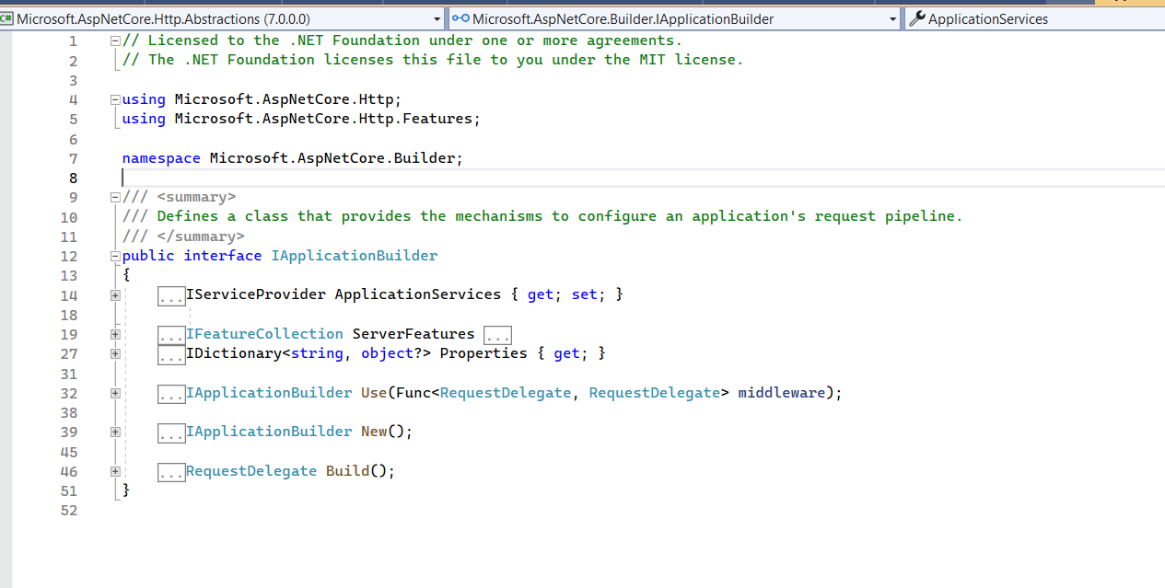
Following class has implemented IApplicationBuilder interface
Microsoft.AspNetCore.Builder.ApplicationBuilder
Microsoft.AspNetCore.Builder.WebApplication
Microsoft.AspNetCore.MiddlewareAnalysis.AnalysisBuilder

Slide 12
How to write custom middleware
How to create custom Middleware?
Asp.net core provided many in-build Middleware but in some scenarios, we need our own middleware to fulfill our requirement, in such case will go with custom middleware.
we will create a separate class for middleware that is called custom middleware.
There are 2 ways to create Custom Middleware in Asp.net Core.
Using IMiddleware interface[Allow you to inject class]
Using the extension method.

Slide 13
Step 1
Create a class and name it “CustomeMiddlewareDemo”
namespace WebApplication1 {
public class CustomMiddlewareDemo {}
}
Step 3
Now we will add code for Custom middleware in the “InvokeAsync” method.
using Microsoft.AspNetCore.Http; using System.Threading.Tasks;
namespace WebApplication1 {
public class CustomMiddlewareDemo: IMiddleware {
public async Task InvokeAsync(HttpContext context, RequestDelegate next)
{
await context.Response.WriteAsync("Hello from Custom Middleware");
await next(context);
}
}
}
Step 2
Inherit “IMiddleware” interface from “Microsoft.AspNetCore.Http” namespace and implement it as per the below code.
using Microsoft.AspNetCore.Http;
using System.Threading.Tasks;
namespace WebApplication1
{
public class CustomMiddlewareDemo: IMiddleware
{
public Task InvokeAsync(HttpContext context, RequestDelegate next)
{ throw new System.NotImplementedException();
}
}
}
app.UseMiddleware < CustomMiddlewareDemo > ();

Slide 14
using MVCMiddleware.Models;
namespace MVCMiddleware
{
public class Program
{
public static void Main(string[] args)
{
var builder = WebApplication.CreateBuilder(args);
// Add services to the container.
builder.Services.AddControllersWithViews();
builder.Services.AddTransient<CustomMiddlewareDemo>();
var app = builder.Build();
// Configure the HTTP request pipeline.
if (!app.Environment.IsDevelopment())
{
app.UseExceptionHandler("/Home/Error");
// The default HSTS value is 30 days. You may want to change this for production scenarios, see https://aka.ms/aspnetcore-hsts.
app.UseHsts();
}
app.UseMiddleware<CustomMiddlewareDemo>();
app.Run(async context => await context.Response.WriteAsync("Hello"));
//app.UseHttpsRedirection();
//app.UseStaticFiles();
//app.UseRouting();
//app.UseAuthorization();
// app.MapControllerRoute(
//name: "default",
//pattern: "{controller=Home}/{action=Index}/{id?}");
app.Run();
}
}
}

Slide 15
Now we will create custom middleware using the extension method,
Right Click on Project -> Add -> new item -> Asp.net Core -> Middleware class
using Microsoft.AspNetCore.Builder;
using Microsoft.AspNetCore.Http;
using System.Threading.Tasks;
namespace MVCMiddleware
{
// You may need to install the Microsoft.AspNetCore.Http.Abstractions package into your project
public class Middleware
{
private readonly RequestDelegate _next;
public Middleware(RequestDelegate next)
{
_next = next;
}
public Task Invoke(HttpContext httpContext)
{
return _next(httpContext);
}
}
// Extension method used to add the middleware to the HTTP request pipeline.
public static class MiddlewareExtensions
{
public static IApplicationBuilder UseMiddleware(this IApplicationBuilder builder)
{
return builder.UseMiddleware<Middleware>();
}
}
}

Slide 16
using Microsoft.AspNetCore.Builder;
using Microsoft.AspNetCore.Http;
using System.Threading.Tasks;
namespace MVCMiddleware
{
// You may need to install the Microsoft.AspNetCore.Http.Abstractions package into your project
public class Middleware
{
private readonly RequestDelegate _next;
public Middleware(RequestDelegate next)
{
_next = next;
}
public async Task Invoke(HttpContext httpContext)
{
await httpContext.Response.WriteAsync("Hello Custom Middleware \n");
await _next(httpContext);
}
}
// Extension method used to add the middleware to the HTTP request pipeline.
public static class MiddlewareExtensions
{
public static IApplicationBuilder UseMiddleware(this IApplicationBuilder builder)
{
return builder.UseMiddleware<Middleware>();
}
}
}

Slide 17
using Microsoft.AspNetCore.Builder;
using MVCMiddleware.Models;
namespace MVCMiddleware
{
public class Program
{
public static void Main(string[] args)
{
var builder = WebApplication.CreateBuilder(args);
// Add services to the container.
builder.Services.AddControllersWithViews();
var app = builder.Build();
// Configure the HTTP request pipeline.
if (!app.Environment.IsDevelopment())
{
app.UseExceptionHandler("/Home/Error");
// The default HSTS value is 30 days. You may want to change this for production scenarios, see https://aka.ms/aspnetcore-hsts.
app.UseHsts();
}
app.UseMiddleware();
app.Run(async context => await context.Response.WriteAsync("Hello"));
//app.UseHttpsRedirection();
//app.UseStaticFiles();
//app.UseRouting();
//app.UseAuthorization();
// app.MapControllerRoute(
//name: "default",
//pattern: "{controller=Home}/{action=Index}/{id?}");
app.Run();
}
}
}

